Slide 1
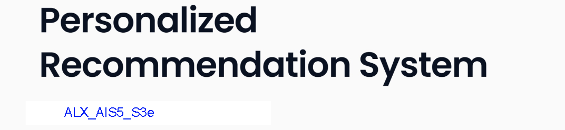

Instructor Name: Mohammed Agoor

Slide 2
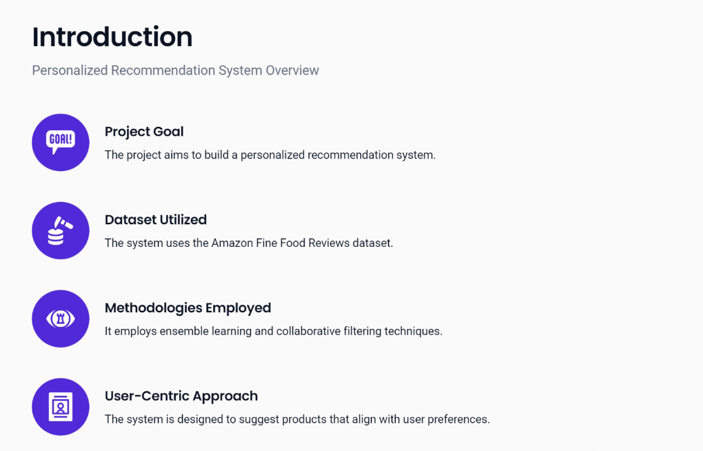

Slide 3


Slide 4
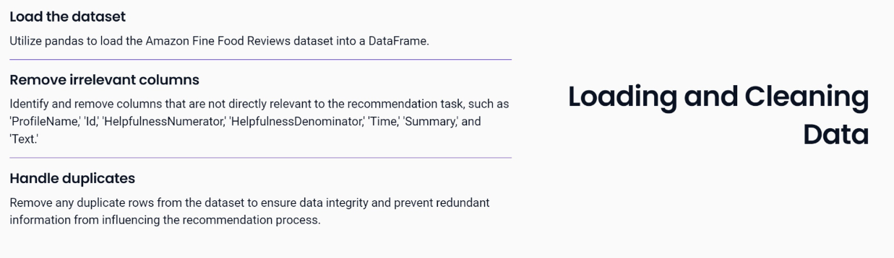
Data Preprocessing:

Slide 5
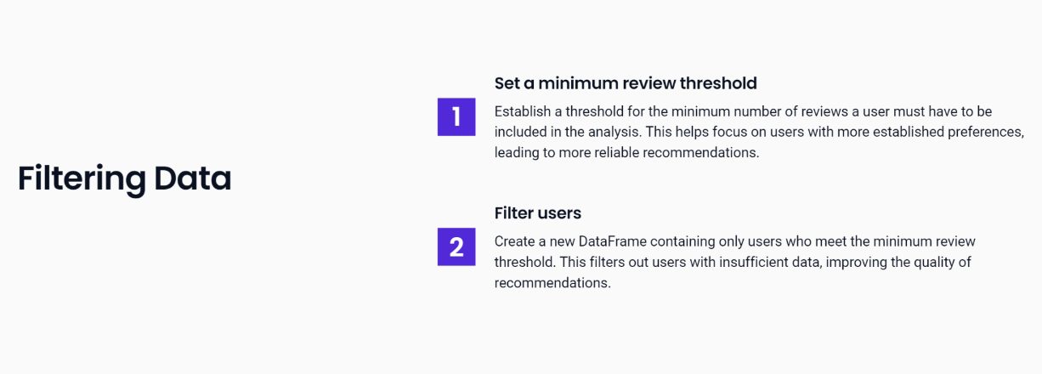

Slide 6
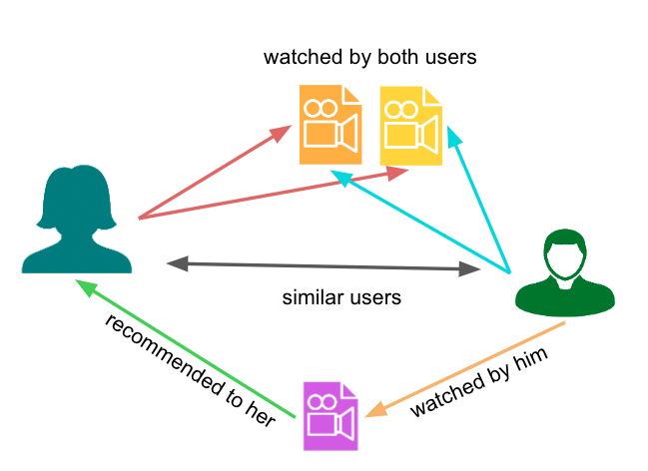
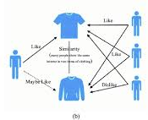
Recommender Systems Overview:
In our Recommendation System we used three approach:
Singular Value Decomposition (SVD).
Collaborative Filtering:
1) User-user 2) Item-item

Slide 7
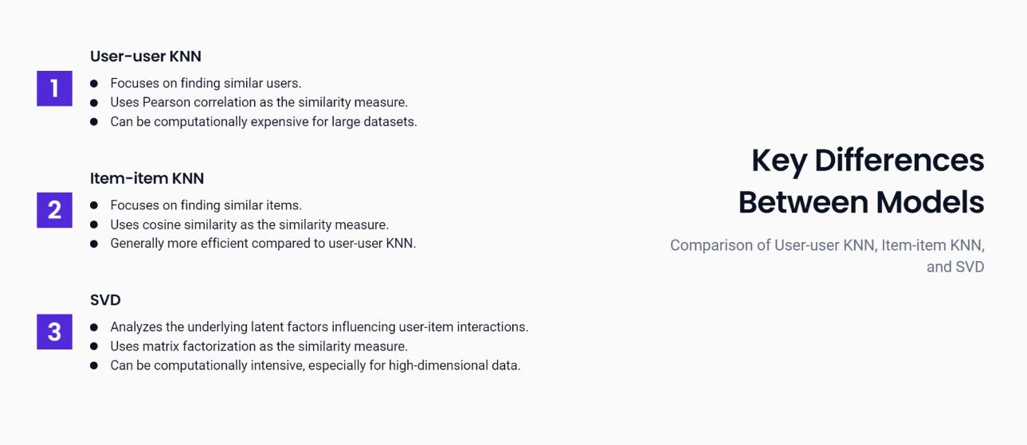

Slide 8
Model Selection:
Choose the best model based on RMSE Values.
Doing MLOps Experiments to indicate the best parameters.

Slide 9
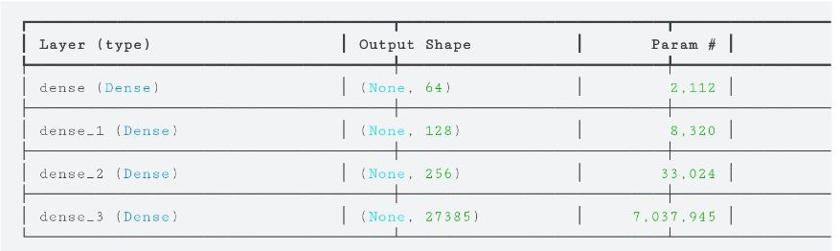
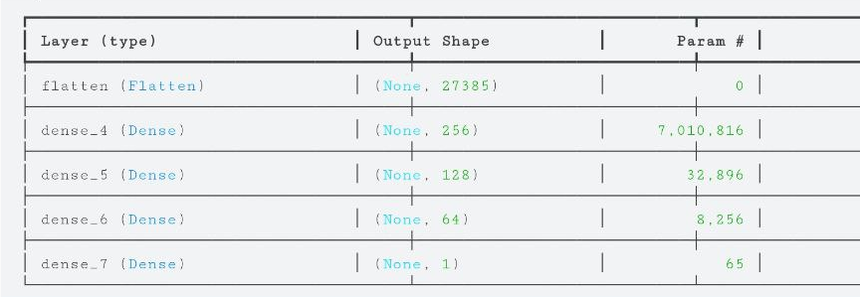
Generative Models:
We used GAN model which consists of generator and discriminator.
GAN used to generate synthetic data containing the same columns used (UserId, ProductId & Score).
Converting data to user-item matrix and used it as an input.
Generator structure Discriminator structure

Slide 10
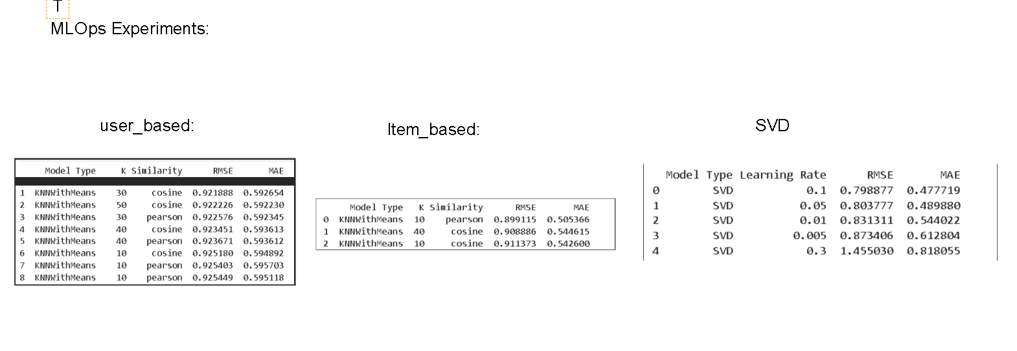
MLOps Experiments:

Slide 11
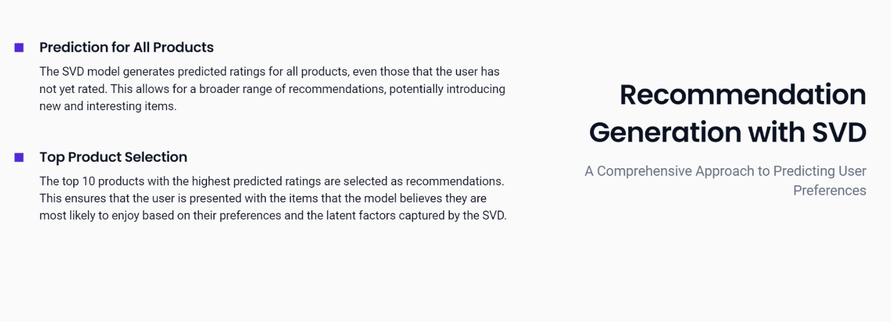

Slide 12
Ensemble Learning Techniques:
1
Model
Training
Separate SVD and KNN models (both user-based and item-based) are trained on the training dataset. This leverages the strengths of different collaborative filtering techniques.
Predictions from the individual models are combined using weighted averaging. This approach allows for balancing the contributions of each model based on their relative performance and the specific characteristics of the recommendation task. For the Ensemble Learning technique we used weight for SVD predictions = 0.7 & weight for user-based KNN predictions = weight for item-based KNN predictions = 0.15
2
3
Weighted Averaging
Evaluation
The combined predictions are evaluated on the test set to assess the overall performance of the ensemble model. This helps fine-tune the weights assigned to each model if necessary.

Slide 13
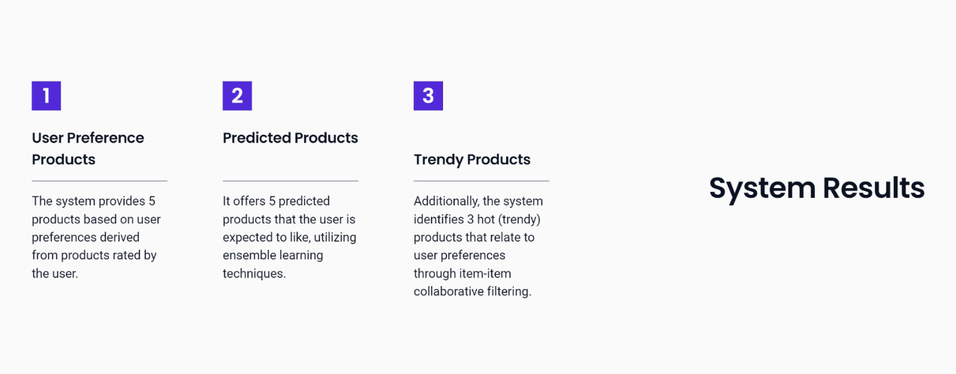

Slide 14

Metrics of Ensemble Learning:
Using Ensemble Learning for prediction gives the best performance.

Slide 15
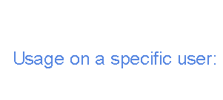
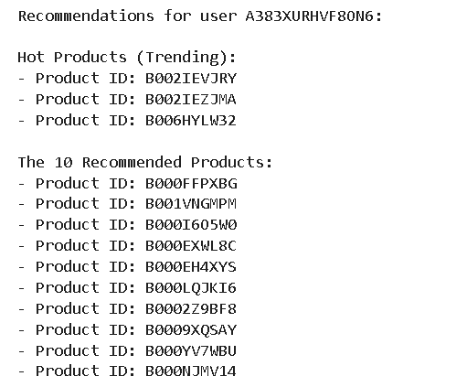

Slide 16

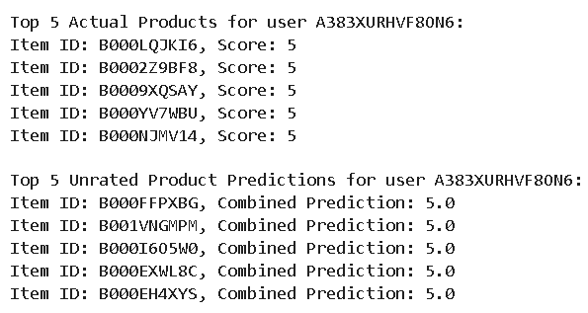
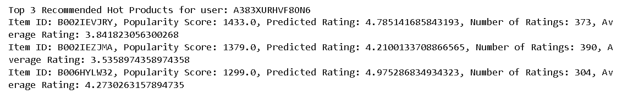

Slide 17
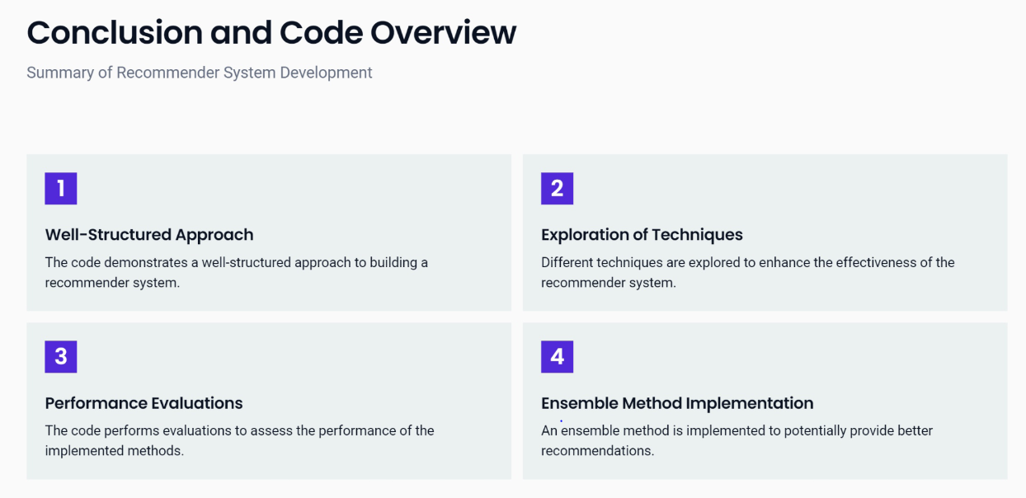

Slide 18
